Slide 1
Coursera Dataset: Exploratory Data Analysis
Presented By: Khristian Novoa

Slide 2
What is this project about?
In this project, I worked with a Coursera dataset that includes course titles, ratings, enrollment counts, difficulty levels, and certificate types.
My goal was to clean the data, explore trends, and use visualizations to better understand which courses and organizations are most impactful.
I used Python, specifically Pandas for data cleaning and transformation, and Matplotlib and Seaborn for creating all he charts you’ll see in the upcoming slides.

Slide 3
Preparing the Data
Cleaning Steps:
Removed unnecessary columns (e.g., Unnamed: 0)
Converted enrollment values like "5.3k" and "1.2M" to numeric
Filled missing values in course_students_enrolled with 0
Standardized text formats (e.g., title casing for organization names)
Data Checks:
Used .info(), .isna().sum(), and .describe() to validate changes
Verified data types and confirmed no NaNs in key columns
Result:
A clean, structured dataset ready for analysis and visualization

Slide 4
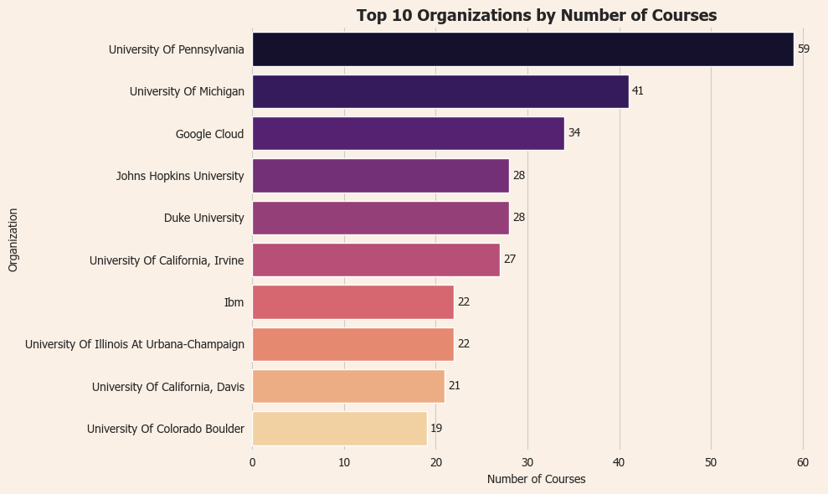
Which Organizations Offer the most Courses?
Top Organizations:
University of Pennsylvania
University of Michigan
Google Cloud
Stanford University
Key Insight:
Top contributors are mostly universities, with a few tech companies
Indicates strong academic partnerships and professional development content

Slide 5
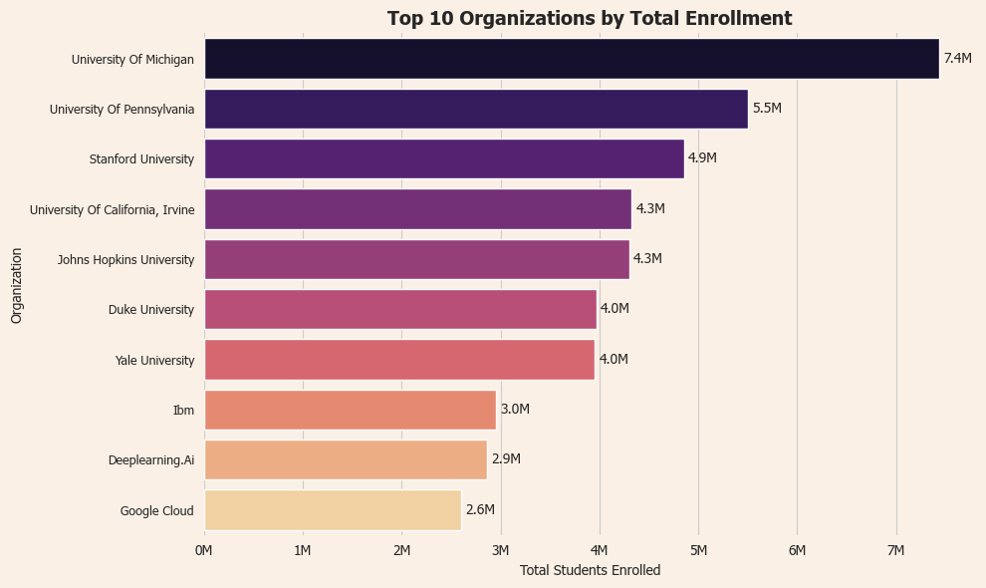
Which Organization is most Popular?
Universities like University of Michigan, University of Pennsylvania, and Stanford have the highest total enrollments
These organizations demonstrate massive reach across their course offerings
Suggests strong brand recognition and high student interest

Slide 6
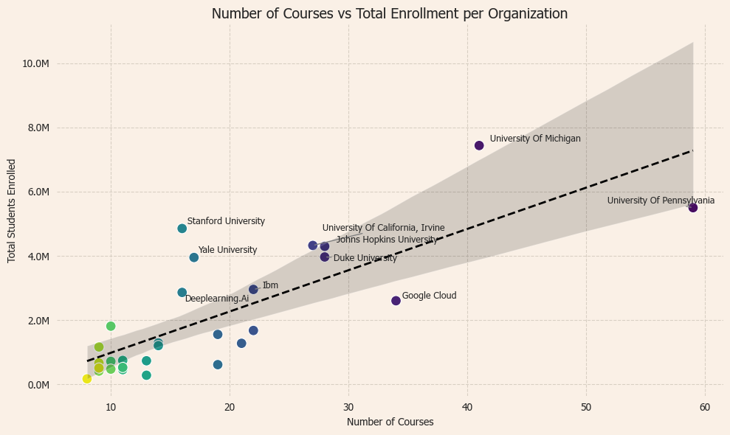
Do More Courses Lead to More Students?
The trend line shows a positive correlation, but with high variance
Outliers like Stanford and Yale show high reach with fewer courses
Organizations above the line are overperforming, those below may be under-leveraging their catalog

Slide 7
Key Takeaways
University of Pennsylvania offers the most courses (59), followed by University of Michigan and Google Cloud
University of Michigan leads in total student enrollment (~7.4M)
Stanford and Yale achieve high enrollment with fewer courses — suggesting strong brand or course quality
Google Cloud has many courses but lower total enrollment, highlighting that quantity doesn’t guarantee impact
Organizations with focused, high-quality offerings tend to reach more learners per course

Slide 8
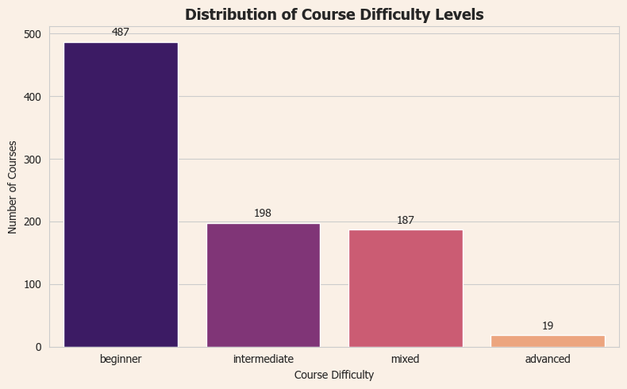
How are courses Distributed by Difficulty?
Most Coursera courses are beginner
Intermediate and Mixed levels make up a smaller portion
Shows Coursera’s emphasis on accessibility and entry-level learning

Slide 9
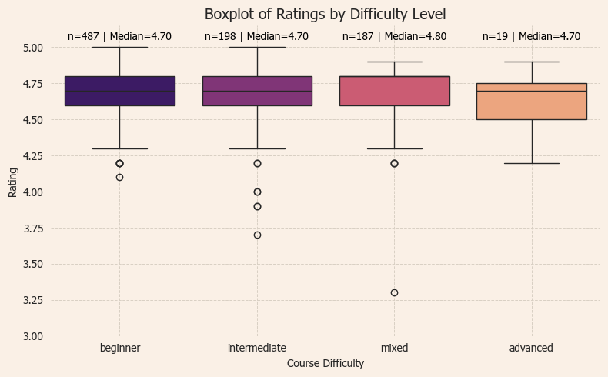
How Do Ratings Vary by Difficulty?
All difficulty levels show consistently high ratings
Beginner, Intermediate, and Mixed courses have a median rating of 4.7
Advanced courses are rated highest, with a median of 4.8
Suggests that learners are satisfied regardless of difficulty level

Slide 10
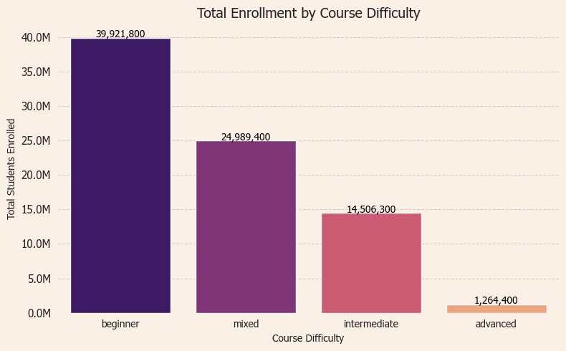
What Courses are Students Taking?
Beginner-level courses dominate, reaching nearly 40 million students
Mixed-difficulty courses also perform well, with over 24 million enrollments
Intermediate-level courses trail behind at around 14.5 million
Advanced courses serve a small but specific group (~1.2 million students)
Suggests Coursera’s largest impact is at the entry-level and foundational skill tiers

Slide 11
Key Takeaways
Beginner-level courses dominate Coursera — both in number and total enrollment
Course quality is consistently high across all difficulty levels
Advanced courses, while few, are highly rated and serve a niche audience
No strong link between number of courses and total student engagement — quality and content matter more than quantity
Organizations can maximize impact by focusing on student-aligned content over just volume

Slide 12
Improvements and Future Work
Track Student Progression Across Difficulty Levels
Analyze if students who take beginner courses go on to enroll in intermediate or advanced courses. This could help measure course effectiveness and student engagement over time.
Identify Multi-Course Learners
Investigate how many courses individual students take. Understanding course stacking behaviors can highlight loyalty, satisfaction, or interest in specific subjects or platforms.
Analyze Trends Year Over Year
Incorporate time-based analysis to see how course popularity, ratings, and enrollments change annually. This could uncover platform growth patterns, shifting student interests, or seasonal trends.
Retention & Drop-off Points (if data becomes available)
It would be valuable to see where learners drop off or what keeps them coming back — this can shape course design or platform strategy.

